Slide 1
Distributed Systems Week 4 – REST and JAX-RS

Slide 2
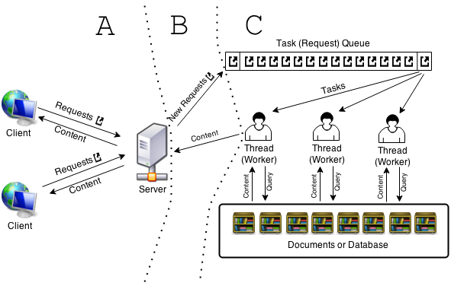
Last Week
Distributed Systems - Week 4: REST and JAX-RS

Slide 3
API
Application Programming Interface
Allows a piece of software to talk with another
REST
REpresentation State Transfer
Make a call and get data back
Distributed Systems - Week 4: REST and JAX-RS
Notes:
a set of functions and procedures allowing the creation of applications that access the features or data of an operating system, application, or other service.
software architecture for interactive applications that typically use multiple Web services. In order to be used in a REST-based application, a Web Service needs to meet certain constraints; such a Web Service is called RESTful.

Slide 4
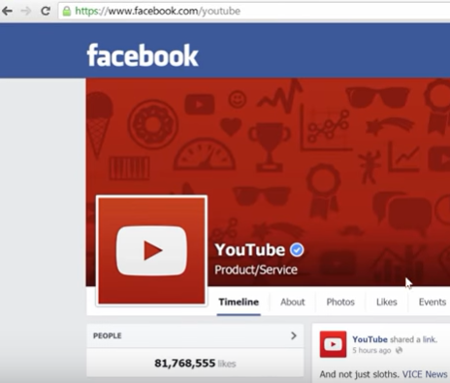
API example
Distributed Systems - Week 4: REST and JAX-RS

Slide 5
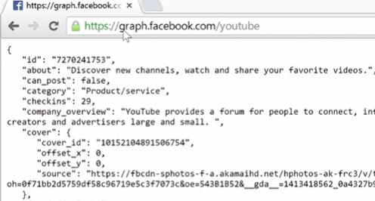
API example
Distributed Systems - Week 4: REST and JAX-RS

Slide 6
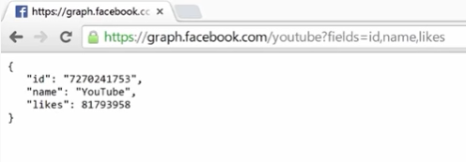
API example
Distributed Systems - Week 4: REST and JAX-RS

Slide 7
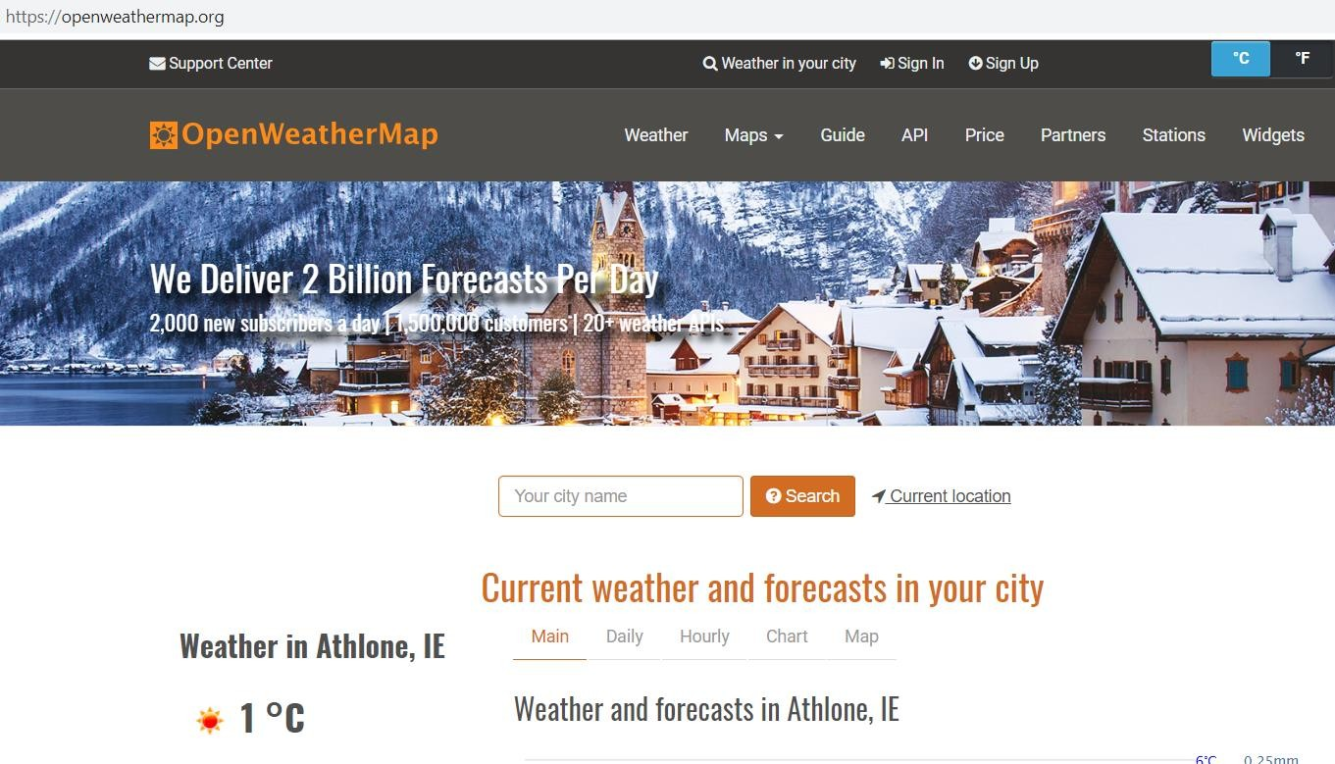
OpenWeatherMap
https://openweathermap.org/
https://openweathermap.org/
Distributed Systems - Week 4: REST and JAX-RS

Slide 8
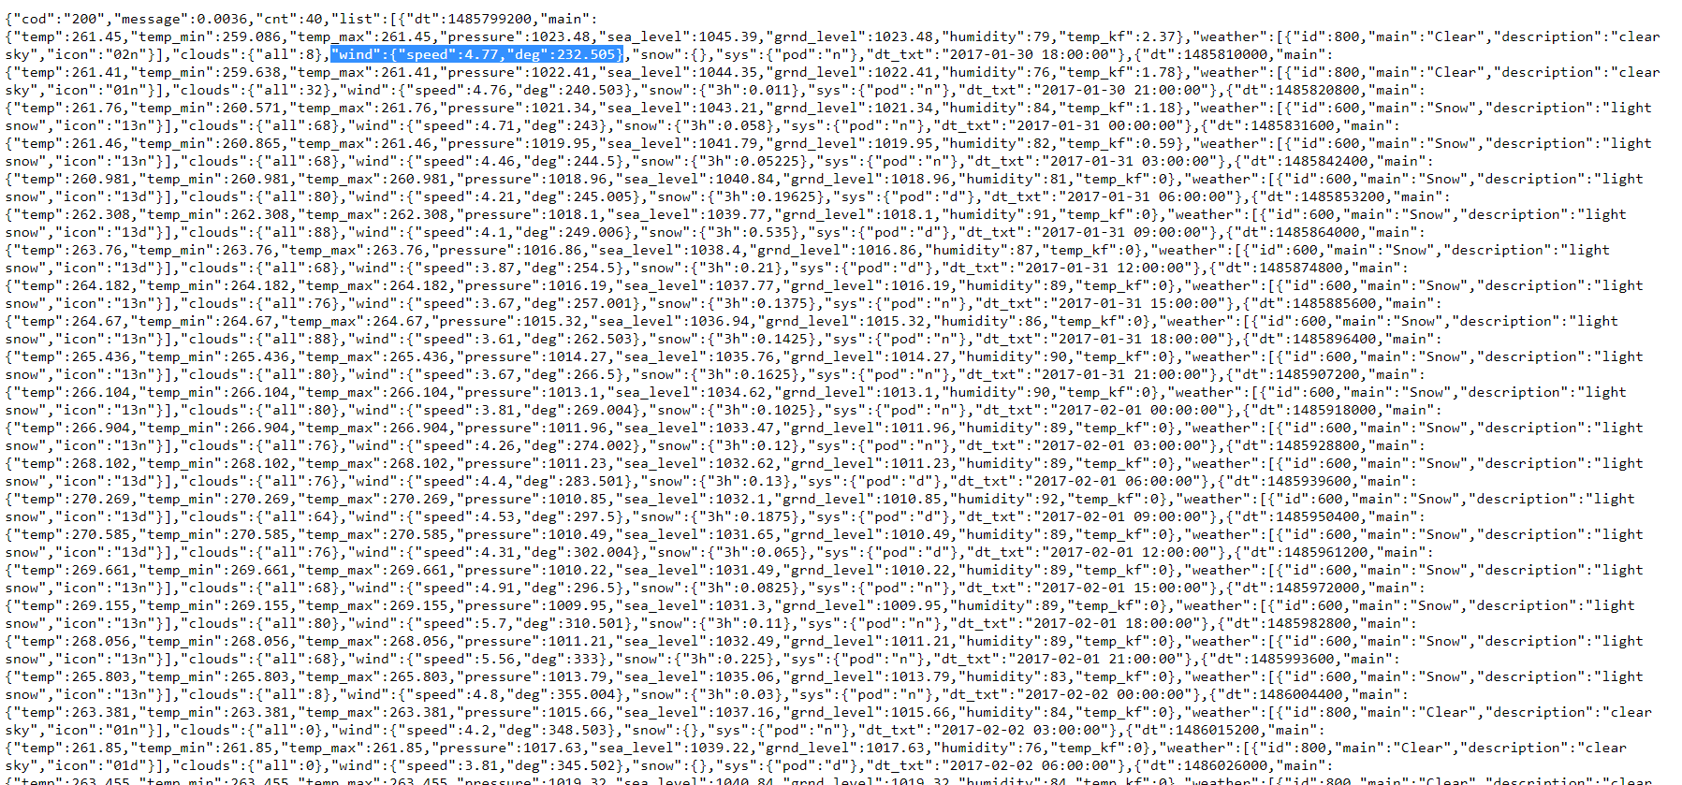
OpenWeatherMap
Distributed Systems - Week 4: REST and JAX-RS

Slide 9
OpenWeatherMap
Distributed Systems - Week 4: REST and JAX-RS

Slide 10
OpenWeatherMap
api.openweathermap.org/data/2.5/weather?lat={lat}&lon={lon}
Distributed Systems - Week 4: REST and JAX-RS

Slide 11
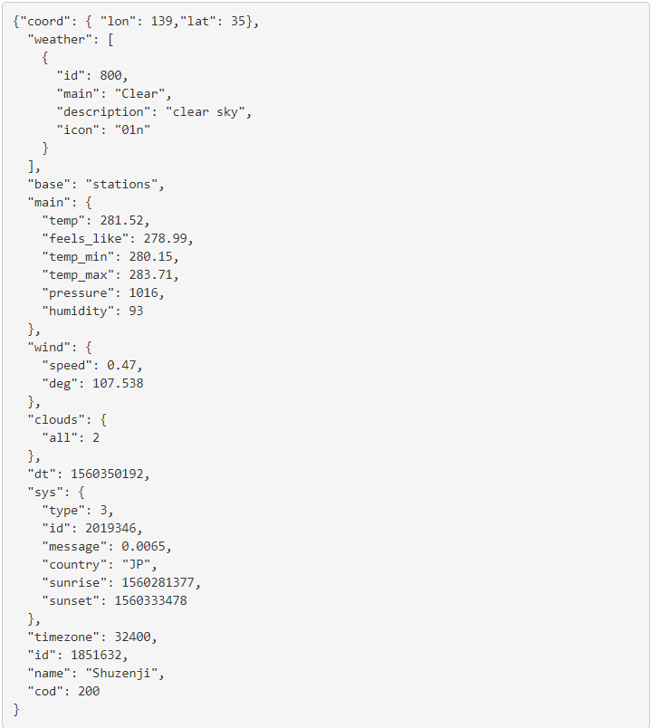
OpenWeatherMap
Distributed Systems - Week 4: REST and JAX-RS

Slide 12

REST
REpresentational State Transfer.
A type of API
An architectural style (not a protocol, so no specific API).
The art or practice of designing something in a structured way.
Distributed Systems - Week 4: REST and JAX-RS

Slide 13
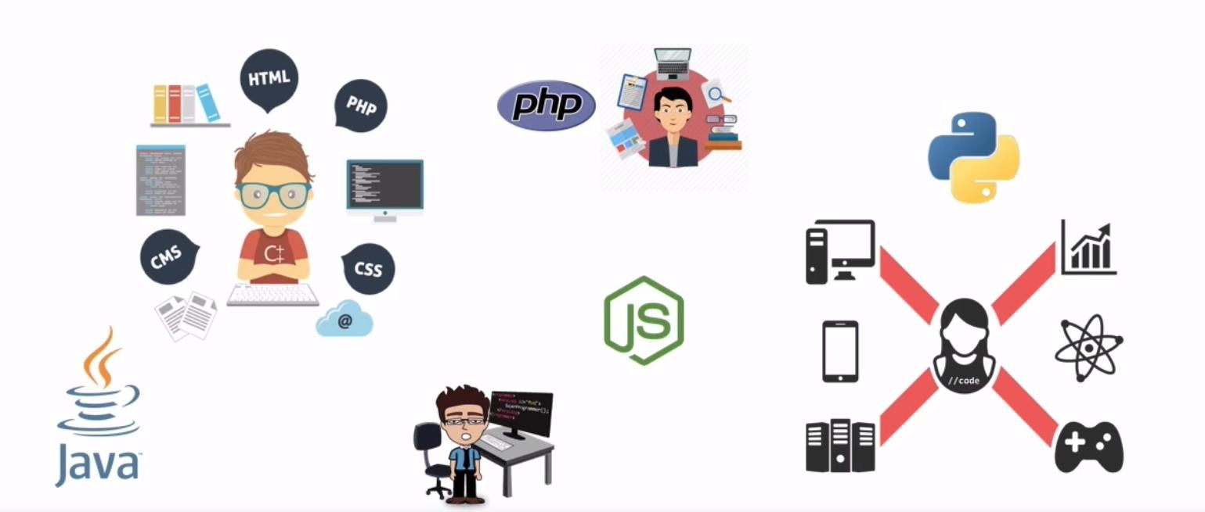
What does REST work with?
Distributed Systems - Week 4: REST and JAX-RS

Slide 14
REST
In a REST based architecture, everything is a resource.
A resource is accessed via a common interface based on the HTTP standard methods.
REST allows that resources have different representations, e.g., text, XML, JSON etc. The REST client can ask for a specific representation via the HTTP protocol (content negotiation).
Distributed Systems - Week 4: REST and JAX-RS

Slide 15
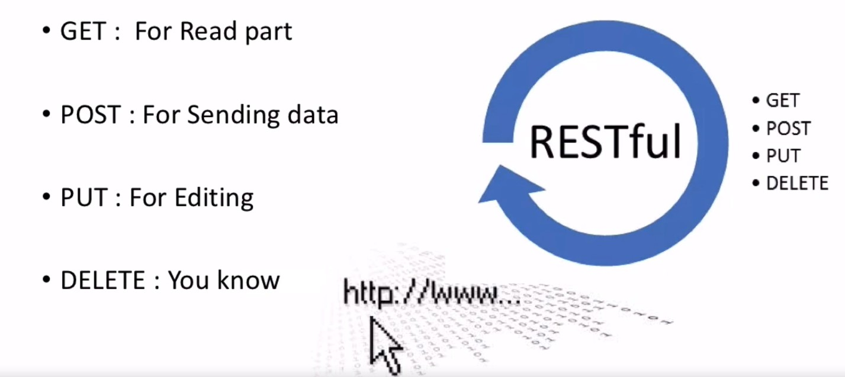
REST Basics
Distributed Systems - Week 4: REST and JAX-RS

Slide 16
REST Methods
The GET, PUT, POST and DELETE methods are typically used in REST based architectures.
GET defines a reading access of the resource without side-effects. The resource is never changed via a GET request, e.g., the request has no side effects (idempotent).
PUT updates an existing resource – idempotent.
DELETE removes the resources. The operations are idempotent. They can get repeated without leading to different results.
POST creates a new resource – not idempotent.
Distributed Systems - Week 4: REST and JAX-RS

Slide 17
To be idempotent
Idempotency is important in building a fault-tolerant API.
To be idempotent, clients can make that same call repeatedly while producing the same result. In other words, making multiple identical requests has the same effect as making a single request.
Note that while idempotent operations produce the same result on the server (no side effects), the response itself may not be the same (e.g. a resource's state may change between requests).
The point of the rule is that if you send the same request multiple times, the state of the server is the same as if you only sent it once.
Distributed Systems - Week 4: REST and JAX-RS

Slide 18
REST
Uniform Interface.
Resources have unique identifiers (URIs in HTTP)
Resources have different representations (XML, XHTML, JSON, TEXT etc)
Clients can request resources by specifying the identity of the resource as well as preferred representations.
Distributed Systems - Week 4: REST and JAX-RS

Slide 19
REST (contd.)
Stateless (No application state is stored on the server. Resource state is of course saved on the server).
HTTP itself is stateless. This is one of the main reasons why it scales so well. (Many Web applications are not stateless. Many use HttpSession objects)
Session (application) state stored on the server causes problems for scalability.
Distributed Systems - Week 4: REST and JAX-RS

Slide 20
JAX-RS
Java defines REST support via the Java Specification Request (JSRJAX-RS) 311.
This specification is called JAX-RS: Java API for RESTful Web Services
uses annotations to define the REST relevance of Java classes.
Distributed Systems - Week 4: REST and JAX-RS

Slide 21
Jersey
Jersey is a framework for developing RESTful Web Services in Java
It provides support for JAX-RS APIs and serves as a JAX-RS (JSR 311) Reference Implementation.
The Jersey implementation provides a library to implement Restful web services in a Java servlet container.
A Java servlet processes or stores a Java class in JavaEE that conforms to the Java Servlet API, a standard for implementing Java classes that respond to requests.
Distributed Systems - Week 4: REST and JAX-RS

Slide 22
Jersey (contd.)
On the server side Jersey provides a servlet implementation which scans predefined classes to identify RESTful resources. In a web.xml configuration file you register this servlet for your web application.
The base URL of this servlet is:
http://your_domain:port/project-name/url-pattern/path_from_rest_class
This servlet analyses the incoming HTTP request and selects the correct class and method to respond to this request. This selection is based on annotations in the class and methods.
Distributed Systems - Week 4: REST and JAX-RS

Slide 23
JAX-RS annotations
Annotation | Description
@PATH(your_path) | Sets the path to base URL + /your_path. The base URL is based on your application name, the servlet and the URL pattern from the web.xmlconfiguration file.
@POST | Indicates that the following method will answer to an HTTP POST request.
@GET | Indicates that the following method will answer to an HTTP GET request.
@PUT | Indicates that the following method will answer to an HTTP PUT request.
@DELETE | Indicates that the following method will answer to an HTTP DELETE request.
@Produces(MediaType.TEXT_PLA IN[, more-types]) | @Produces defines which type is delivered by a method annotated with @GET. In the example text ("text/plain") is produced. Other examples would be "application/xml" or "application/json".
@Consumes(type[, more-types]) | @Consumes defines which MIME type is consumed by this method.
@PathParam | Used to inject values from the URL into a method parameter. This way you inject, for example, the ID of a resource into the method to get the correct object.
Distributed Systems - Week 4: REST and JAX-RS

Slide 24
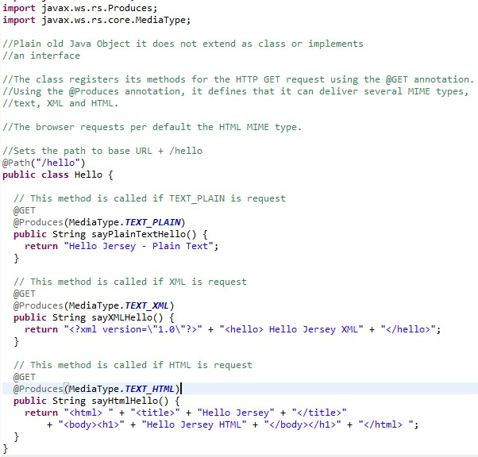
Server Example (Lab3)
http://localhost:8080/Lab3/question1/hello
Distributed Systems - Week 4: REST and JAX-RS

